Slide 1


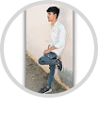
Karan Portfolio
Author: Karan CS
Created with Pi

Slide 2

CONTENTS
1. Projects
2. Experience
3. Achievements
4. Contact Me
5. About Me
6. Certificates
7. Curriculum Vitae

Slide 3

01
Projects

Slide 4

Project Portfolio
Project Website
Project registration for the Project Blog Template

Slide 5

02
Experience

Slide 6

Internship
Internship at Yectra Technologies, Kovai: Web Development (2024)
Freelancer: Built websites for small businesses

Slide 7

03
Achievements

Slide 8

Achievements
Winner: Coding Competition 2023
Top Performer: Web Development Bootcamp
Certificate of Excellence in HTML & CSS

Slide 9
04
Contact Me

Slide 10



Contact Me
Email
karancs2184@mail.co
Phone
+91 9597942184

Slide 11
05
About Me

Slide 12

About Me
Hi! I'm Agni, passionate about creating modern websites and applications. I love learning new technologies and building interactive, user-friendly designs.

Slide 13
06
Certificates

Slide 14
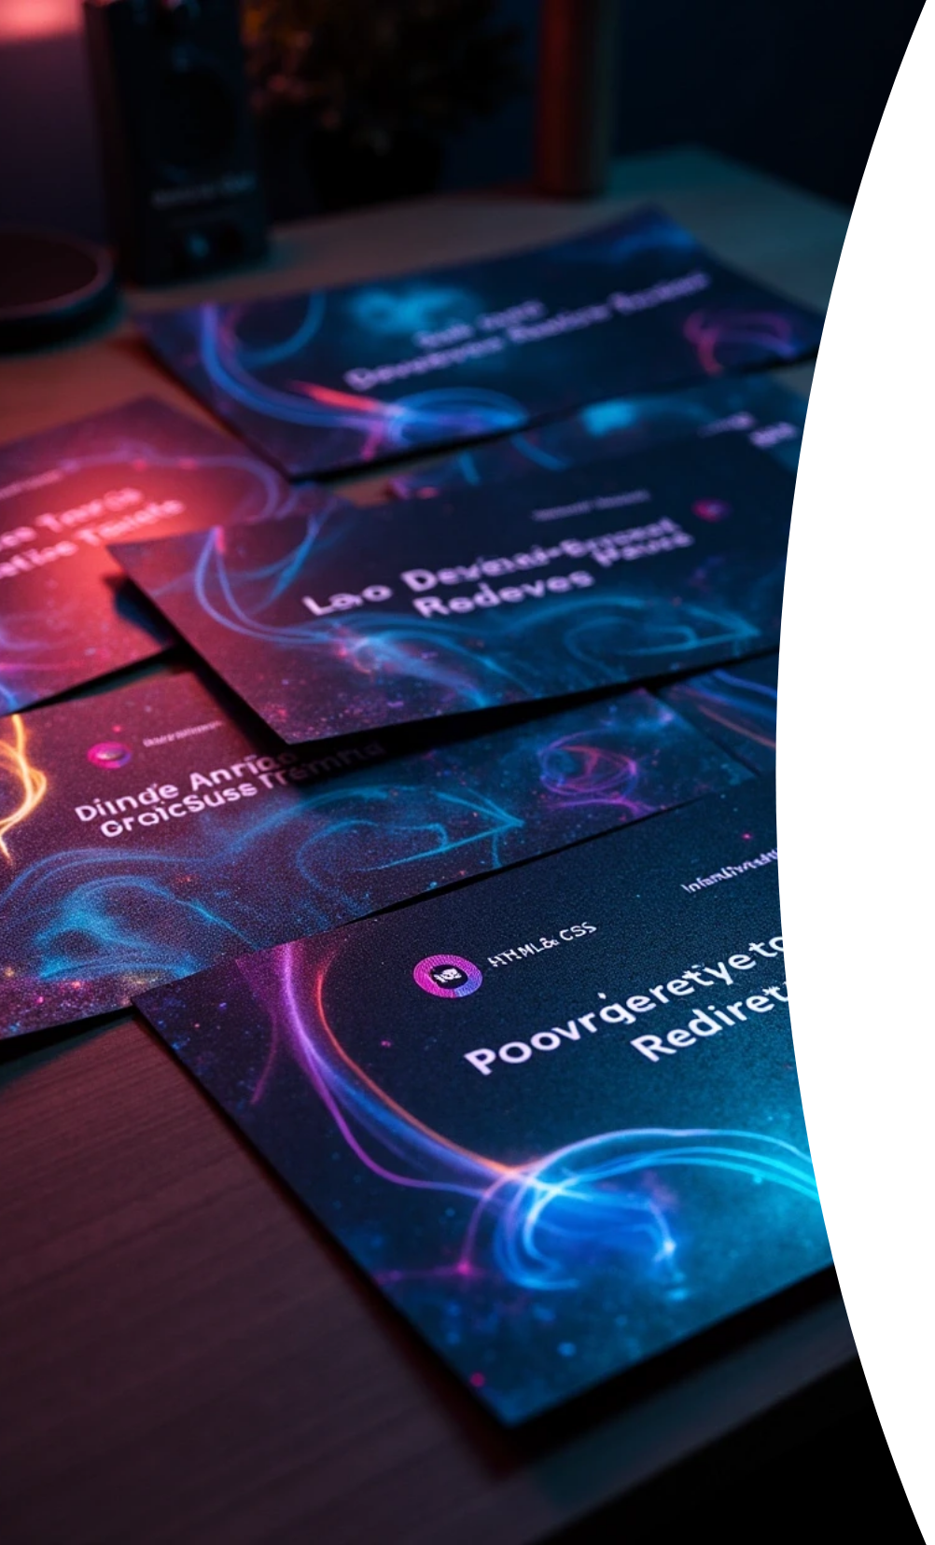


Certificates
Web Development Basics: Certificate
Developing Sites for Web: Certificate
HTML & CSS: Certificate
Front-End Development: Certificate

Slide 15
07
Curriculum Vitae

Slide 16



Curriculum Vitae
Name
Address
Email
Age
Karan P
Dharmapuri
agni@example.com
19 (Major)
Gender
Father
Mother
Brother
Male
Perumal
Munirathinam
Hakash
Siblings
Marital Status
Known Languages
Degree Graduated
1
Single
Tamil, English
No
First Graduate
Yes

Slide 17








Extra-Curricular Activities
1
2
3
4
Sports
Gaming
Cooking
Dancing

Slide 18





Education
10th: Government Higher Secondary School, Amani Mallapuram\
12th: Government Higher Secondary School, Amani Mallapuram\
College Education (B.Sc Computer Science)\
Percentage: 63.2%
Percentage: 63.1%
Govt Arts and Science College, Anthiyur, Bharathiyar University - Coimbatore
HTML: 90%
CSS: 75%
Java: 65%
© 2025 Agni. All Rights Reserved.

Slide 19
Thank You

